Slide 1
Occupational Safety and Health Legislature in Sri Lanka

Slide 2
Labour code of Sri Lanka
Comprises 7 chapters
Chapter 1 – Labour relations (industrial disputes, trade unions, termination of employment of workmen, employees councils)
Chapter 2 – Terms and conditions of employment (wages boards ordinance, shop and office employees, employment of trainees, budgetary relief allowance of workers)
Chapter 3 – Employment of women, young persons and children (Employment of females in mines, maternity benefits, employment of women, young persons and children Act)
Chapter 4 deals with Occupational Safety and Health and Payment of Workmen’s Compensation (Factories ordinance, Workmen’s Compensation Ordinance)

Slide 3
Labour code of Sri Lanka
Chapter 5 – Social security (Employees Provident Fund, Employees Trust Fund, Gratuity payments)
Chapter 6 – Foreign employment (Fee charging employment agencies, Sri Lanka Bureau of Foreign Employment Act)
Chapter 7 – Miscellaneous (Estate labour ordinance, medical wants ordinance, Indian immigrant labour ordinance, minimum wages (Indian labour) ordinance, trade union representatives (entry into estates) Act, estate quarters act, allowance to plantation workers Act, service contracts Act)

Slide 4
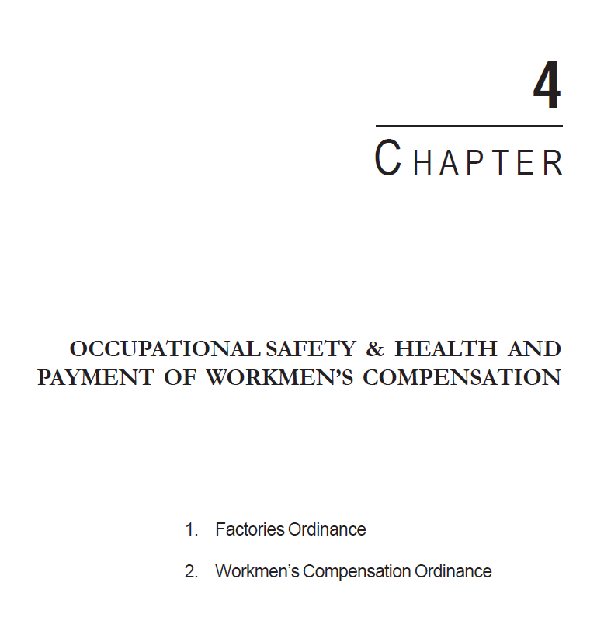
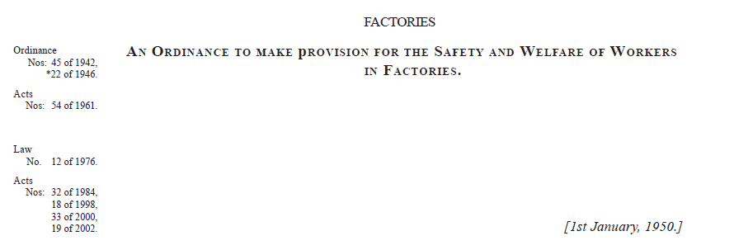

Slide 5
What is a factory?
The Factories Ordinance defines the term “factory” as premises in which persons are employed in manual labour for the purpose of trade or gain in making, repairing, ornamenting, finishing, washing, cleaning or adopting for sale of any article.

Slide 6
Factories Ordinance
Consists of 15 parts (332 pages)
Part I – Registration of factories and approval of factory buildings
Part II – Health (General Provisions)
Part III – Safety (General Provisions)
Part IV – Welfare (General Provisions)
Part V – Health Safety and Welfare (Special Provisions and Regulations)
Part VI – Notification and Investigation of Accidents and Industrial Diseases
Part VII – Employment of Women and Young Persons Hours and Holidays

Slide 7
Factories Ordinance
Part VIII – Special applications and extensions Premises in Respect of which Owner is Liable.
Part IX – Home Work
Part X – Miscellaneous
Part XI – Administration
Part XIII* - Supplementary (Offences, Penalties and Legal Proceedings)
Part XIV – Application of Ordinance
Part XV – Interpretation and General Interpretation

Slide 8
Part II - Health
Cleanliness (dirt, refuse, etc)
Overcrowding (<400 cu.ft)
Regulations increasing amount of cubic space allowance for each person
Calculating the amount of cubic space in a room
Notice of number of persons employed in each room (by District Factory Inspecting Engineer)
Temperature, ventilation, lighting, drainage of floors, sanitary conveniences)
Power to require medical supervision

Slide 9
Part III (Safety-General Provisions)
Safety of machinery
Cleaning of machinery
Training of supervision of young persons working at a dangerous machine
Safe means of access and safe place of employment
Means of escape in case of fire and fire fighting equipment
Regulation of use of machinery

Slide 10
Part IV (Welfare)
Drinking water
Washing facilities
Accommodation for clothing
First aid
Resting facilities

Slide 11
Part V – Health, Safety and Welfare (Special Provisions)
Removal of dust and fumes
Precautions where asphyxiant or irritant gas or vapour is used
Meals in certain dangerous trades (lead, arsenic etc)
Protection of eyes
Protection from radiation and vibrations
Prevention of noise etc.

Slide 12
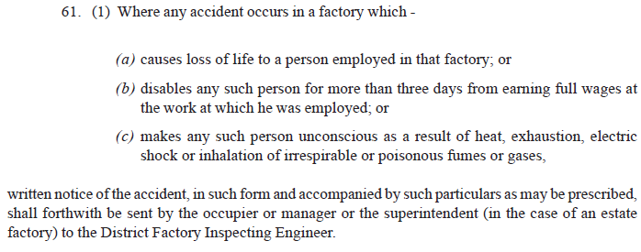
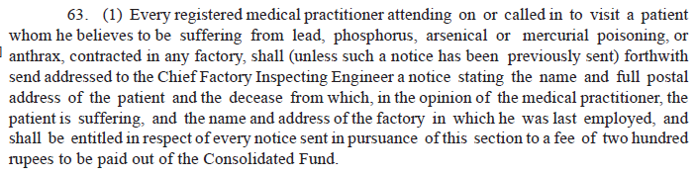
Part VI – Notification and investigation of accidents and industrial diseases

Slide 13
Notification to District Factory Inspecting Engineer
All fatal accidents
Accidents that disable any person for more than three days from earning full wages at work.
Accident that makes any person unconscious as a result of heat, exhaustion, electric shock or inhalation of irrespirable or poisonous fumes or gases.
Every case of dangerous occurrence such as explosions, fire, collapse of buildings, collapse of cranes, etc.
Prescribed industrial diseases.

Slide 14
Industrial Safety Division
Inspection of factories
Registration of factories
Approval of building plans
Investigation of accidents
Attend coroner’s courts to give expert evidence
Investigation of complaints
Institute legal actions
Conduct safety awareness programmes
Analysis of accidents
Appointment of authorized officers

Slide 15
Occupational Hygiene Division
To promote and maintain the highest possible level of physical, mental and social well-being of the Sri Lankan work force.
To prevent workers deviating from good health to ill health due to exposure to hazards and risks encountered at work.
To provide consultancy, advisory and advocacy services on occupational health.
To provide training, educational and awareness programmes on occupational health.
To provide environmental and biological monitoring facilities to industries.
To embark on research activities aimed at improving occupational health of workers.

Slide 16
Workmen’s Compensation Ordinance
If personal injury is caused to a workman by accident arising out of and in the course of his employment his employer shall be liable to pay compensation in accordance with the provisions of this Ordinance
Amount of compensation
Payment, distribution and recovery of compensation
Insurance (most companies are insured)
Appeals

Slide 17
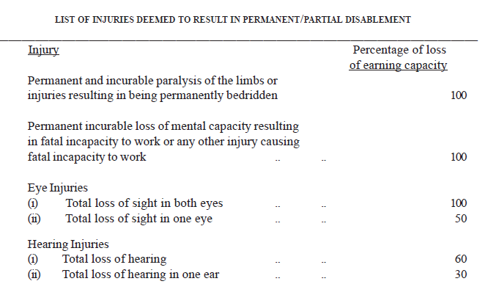

Slide 18
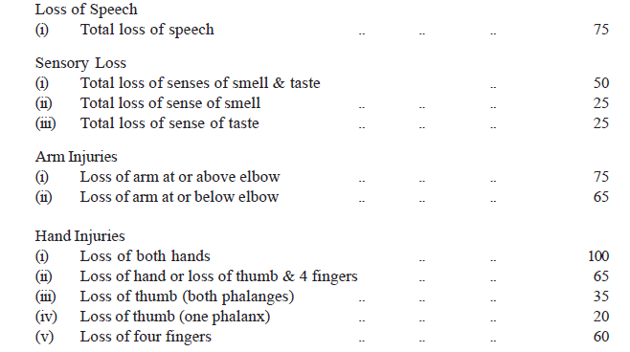

Slide 19
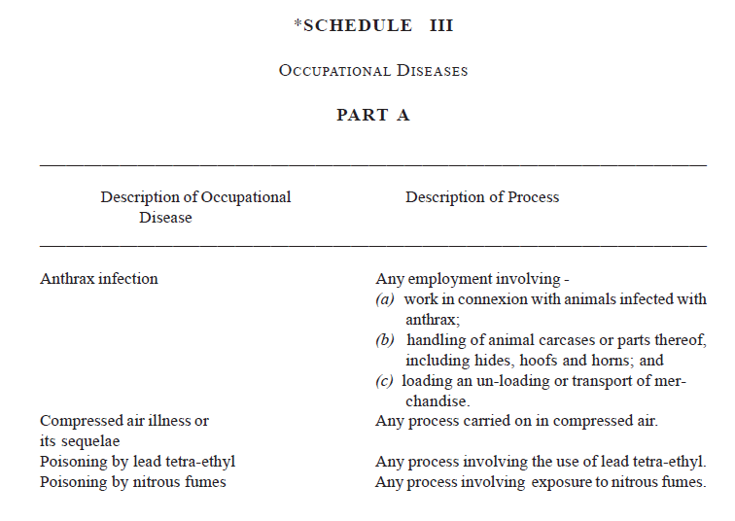

Slide 20
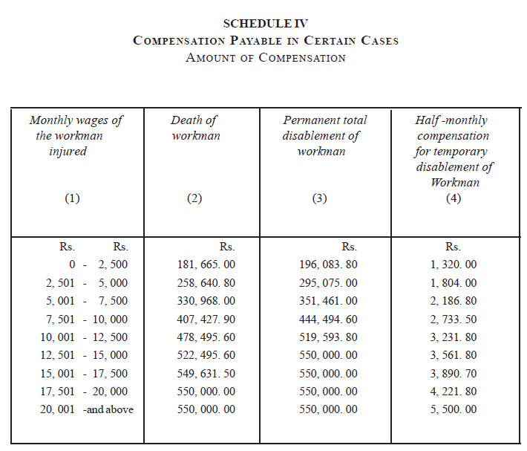

Slide 21
Office of Commissioner of Workmen’s Compensation
Functions in judicial capacity
The Commissioner, Additional Commissioner and the Deputy Commissioner are full time Judicial Officers.
The office of the Commissioner for Workmen’s Compensation is vested with both District Court and Magisterial powers in enforcing its orders.
The objective of this Ordinance is to obtain compensation from employers to workmen injured from accidents while at work or to workmen suffering from diseases attributable to the nature of employment and to their dependents in case of death of workmen from such causes.

Slide 22
Activities carried out by the Commissioner of Workmen’s Compensation
Receipt of complaints claiming workmen’s compensation.
Conducting inquiries in to the accepted applications for compensation and settlement of the problem either by obtaining the claim or by rejecting it.
Collection of compensatory payments from employers.
Payment of compensation to disabled or diseased workmen or to the dependents of dead workmen.

Slide 23
Maternity Benefits
12 weeks (84 working days) full pay leave (This excludes holidays, Saturdays and Sundays)
Can take 2 weeks prior to delivery
State sector employees
“Half pay leave” – further 84 days (but this includes Saturdays and Sundays and the person will be on half pay).
“No pay leave” – further 84 days (but this includes Saturdays and Sundays and the person will not get a salary).

Slide 24
Maternity Benefits
Other benefits
Mothers are entitled to 1.5 hours of leave during working hours (either in the morning or afternoon) until the baby is 6 months old

Slide 25
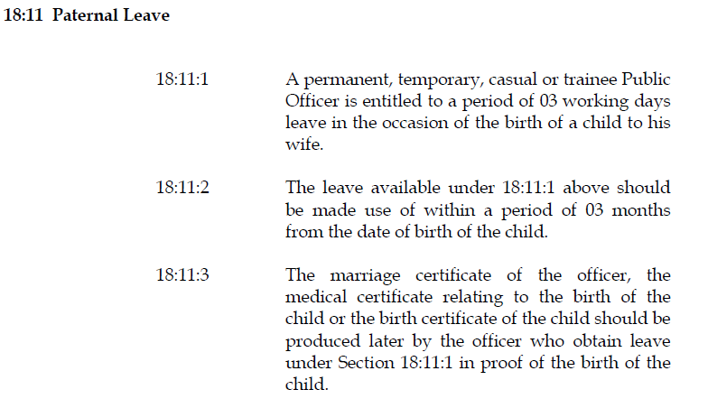
Paternal Leave

